Slide 1
System, Organogram & SDLC
System Analysis and Design
Content 01

Slide 2
Course Outline
Introduction to System and SDLC
Different Types of System/Software
Requirements/ Info Gathering Techniques
System Analysis (including benchmark analysis)
Feasibility Analysis
System Design (Structures/UML Diagrams)
Project Management (Scheduling and Budgeting)
SRS – Software Requirement Specification

Slide 3
Introduction to System and SDLC
Define System
System Organogram/ Structure
SDLC (System/Software Development Life Cycle)
Modern SDLC mindsets

Slide 4
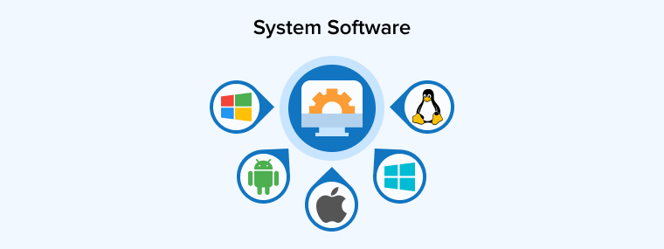
What is System?
The term System is derived from the Greek word Systema, it shows:
An organized relationship among the Functional Units
Shows Interrelation and Interdependence among Functional Units or within Functional Units
Shows Scope/Boundaries (for all functional units)
Shows purpose/ objectives/ goals of the system.
*Central goal gets priority over sub/units goal

Slide 5
Key characteristics of System
Components (subsystems/parts)
Interrelationships (how components connect)
Boundary (what is inside/outside the system)
Inputs → Processes → Outputs
Goals/Objectives (purpose)
Environment (external factors influencing the system)
Feedback/Control/Behavior (monitoring performance)

Slide 6
Examples of Systems

Slide 7
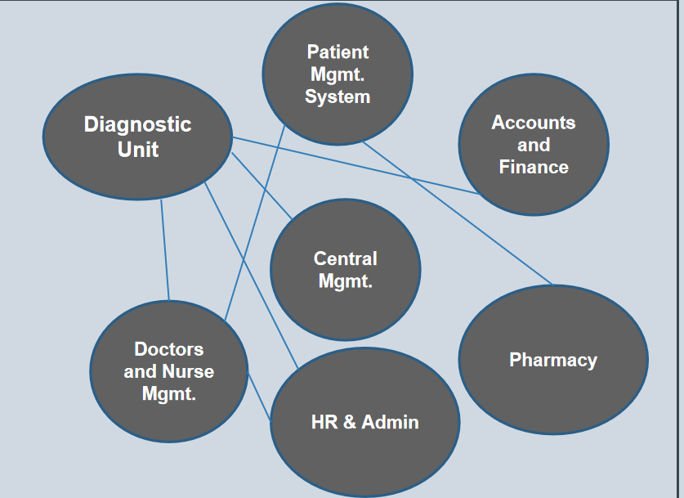
Hospital Management System

Slide 8

University Management System
Academic Management
Admissions Office
Finance and Accounts
Library Management
Faculty and Staff Management
HR & Administration
Central Management

Slide 9
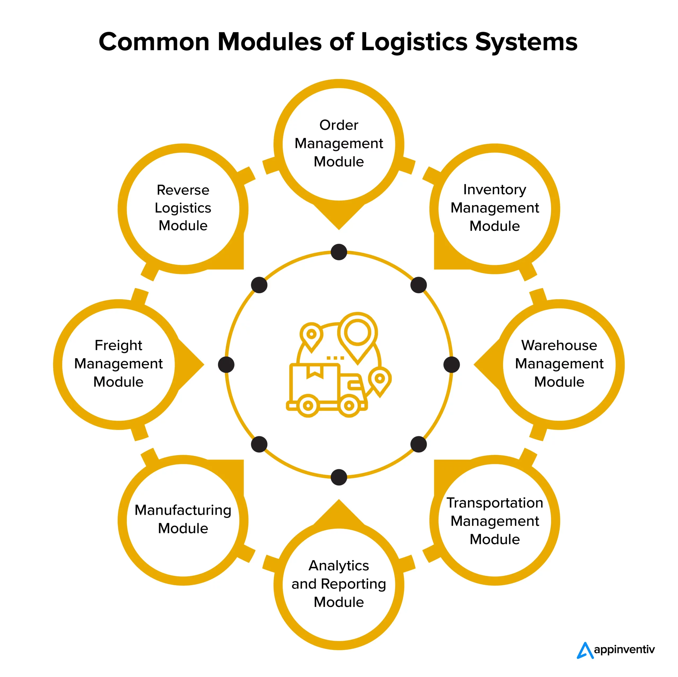
Logistics System

Slide 10
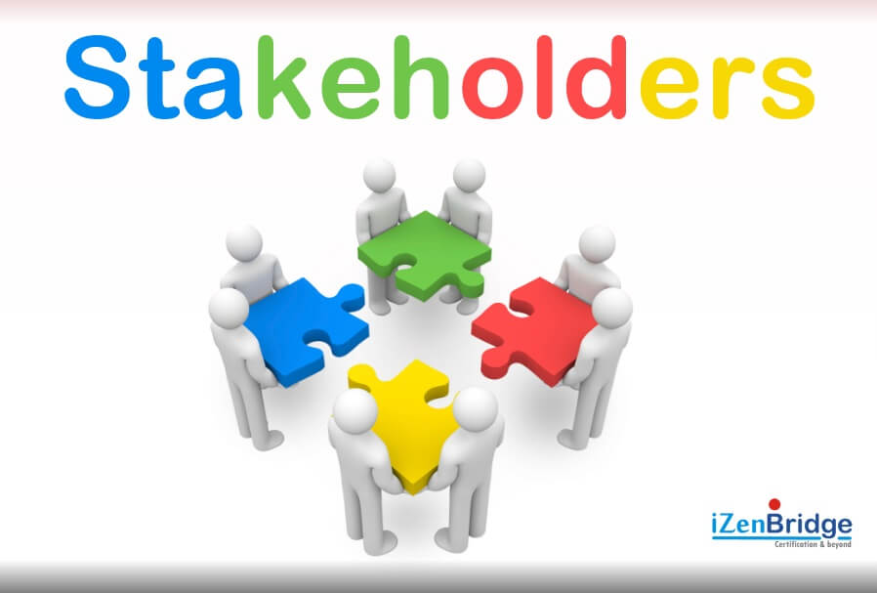
System Stakeholders
Stakeholders are individuals, groups, or organizations that interact with, benefit from, influence, or are affected by the system.
Internal
External
Primary
Secondary

Slide 11
Types of stakeholders
Internal Stakeholders | External stakeholders | Primary stakeholders | Secondary stakeholders
System owner Users (employees, staff) Managers Developers Support / maintenance team | Customers Suppliers/vendors Regulatory bodies Partners | Directly use or depend on the system to perform daily activities. | Indirectly affected or interact occasionally.

Slide 12
System Organogram
An Organizational chart, or Organogram, is a diagram that shows how an organization is structured, and how the positions in the organization are related to each other.
1. Hierarchical Organogram
2. Flat Organogram
3. Matrix Organogram

Slide 13
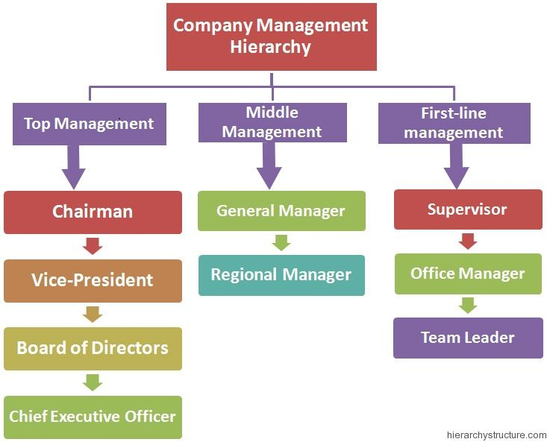
Hierarchical Organogram
A hierarchical organogram is a visual representation of an organization that shows the relationships between different positions and departments within a company.

Slide 14

Flat Organogram
A flat organogram is a chart that shows an organization with few or no middle management layers, connecting staff directly to executives.

Slide 15
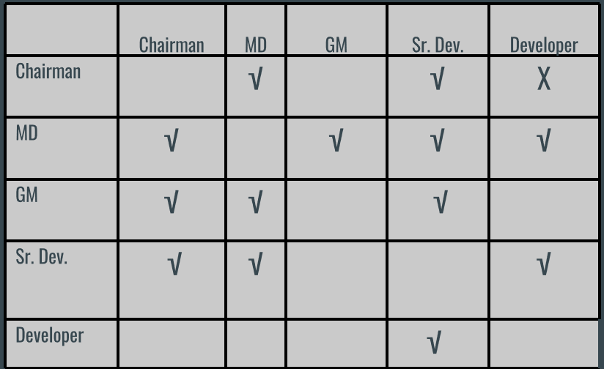
Matrix Organogram
A matrix organogram is a chart that shows a structure where employees report to more than one manager, instead of just one.

Slide 16
System Development Life Cycle (SDLC)

Slide 17
What is SDLC?
The Software Development Life Cycle (SDLC) is a systematic process used by software development teams to design, develop, test, and deploy software applications which means to create a system or software.
Benefits of following SDLC
Covering all Requirements
Ensuring Quality
Making it cost effective
Ease of maintenance
Future Expansion will be easier

Slide 18
7 Phases of the Software Development Life Cycle
Idea Generation
1. Planning
2. Requirement Gathering / System Information
Analysis
3. Design
4. Development/Construction/Coding
5. Testing
6. Deployment
7. Post–Implementation & Maintenance

Slide 19
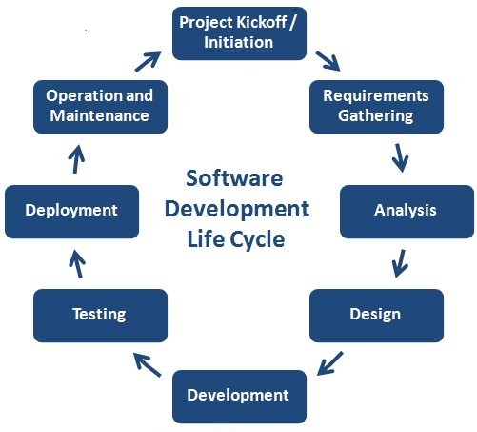
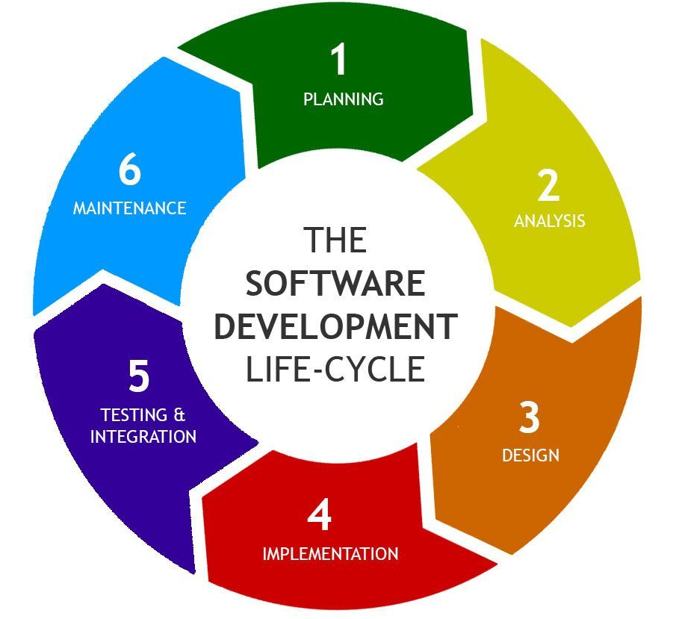
SDLC Phases

Slide 20

Idea Generation
Idea : Think of creative solutions that address user needs.
Feasibility : Check if the idea is realistic in terms of time, budget, and technology.

Slide 21
1. Planning
Define the scope and purpose of the software project. Clearly explain what the software will do and why it is being developed. You must plan about the basic of the following things.
Feasibility Study
Resource Allocation
Project Planning
Risk Assessment

Slide 22

2. Requirements / Information Gathering
Gather detailed functional and non-functional requirements from stakeholders and all possible sources.
Conduct interviews, surveys, and meetings with stakeholders.
What are the requirement need to develop the project

Slide 23
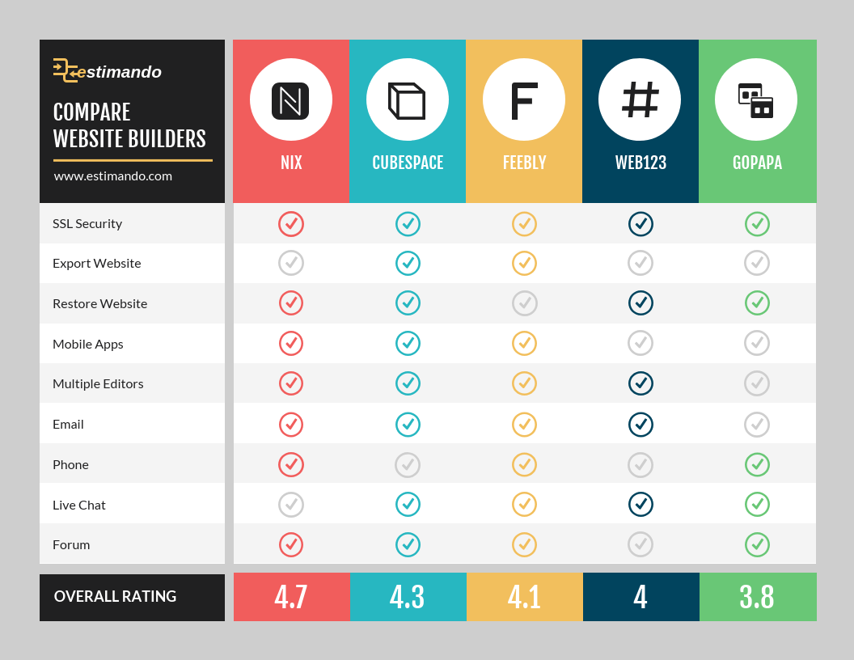
System Analysis
Feature Comparison
Gap Analysis
Feature List Fixation

Slide 24
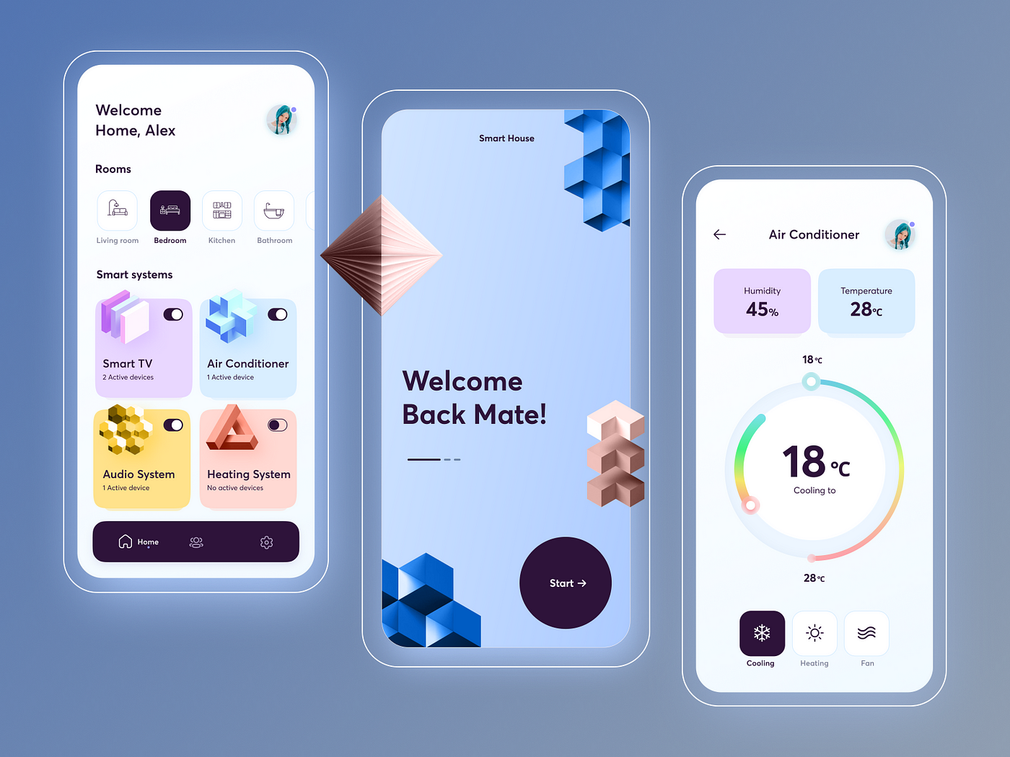
3. System Design
Create the architecture and design of the software.
UML design
DB
UI design
Structured design
Prototype
SRS document delivery

Slide 25

4. Development
Develop the actual software code based on the design specifications.
Coding
Repository
Unit Testing
Code Review
Integration
Change Management

Slide 26
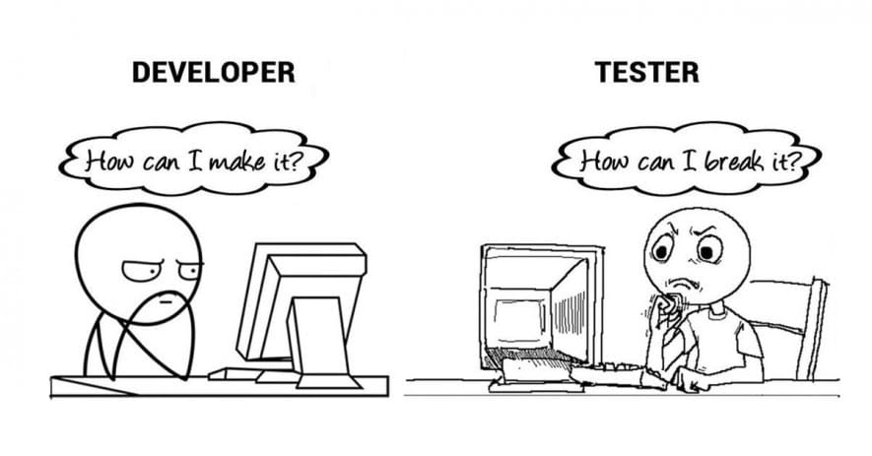
5. Testing
Ensure the software meets all requirements and is free of defects.
Bug fixing
UX
QA
Documenting

Slide 27

6. Deployment
Release the software to production environments for end-users.
Server setup
Product delivery
Training
User manual/ tutorials
Data migration/entry

Slide 28
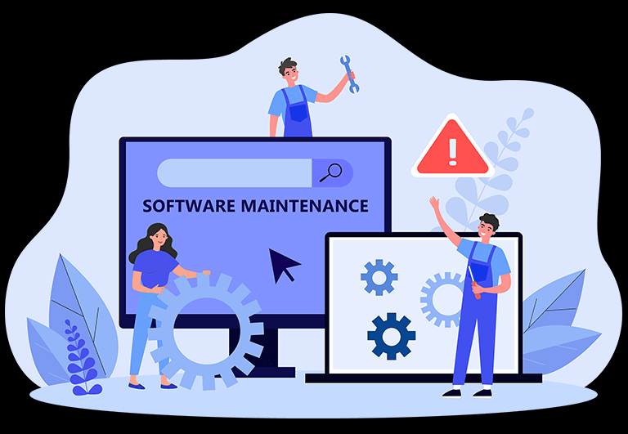
7. Maintenance
Provide ongoing support and enhancements to the software after deployment.
Bug/issue/troubleshooting
Receive feedback from users
Delivers list of updated requirements

Slide 29
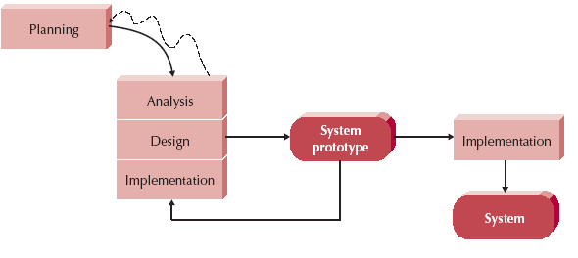
Prototyping - An SDLC-based Methodology
Implementation:
Coding, Testing, Deployment
User
OK by User
Feedback
User Feedback

Slide 30
Modern SDLC Mindsets
Modern SDLC focuses on selecting development approaches that balance efficiency, quality, and the ability to adapt to change.
Three Common Approaches:
Waterfall
Iterative
Agile

Slide 31
Waterfall vs. Iterative vs. Agile
Waterfall (Traditional) | Iterative | Agile
Follows a linear, step-by-step process. Requirements are set before development starts. Hard to change anything once phases move forward. Good for projects with clear, stable requirements. | System is built through repeated cycles Each new cycle improves the previous one. Helps reduce risk by learning early. Useful when requirements are not fully known. | Flexible and team-oriented approach. Work is done in small parts (sprints). Constant user feedback guides improvements. Adapts well to fast-changing requirements. Agile is best when requirements are flexible and you need to adapt quickly.

Slide 32
Thank You!

